Slide 1

Mini Module: Logic Circuits
Learning Outcomes:
Students will be able to identify and describe the basic types of logic gates (AND, OR, NOT) and their functions.
Students will be able to construct simple logic circuits and simulate them using software.
Students will be able to predict the output of a logic gate given different combinations of inputs.
This material was developed as part of a grant received from the National Science Foundation, Award Number 1905734

Slide 2
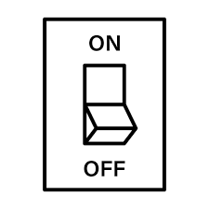
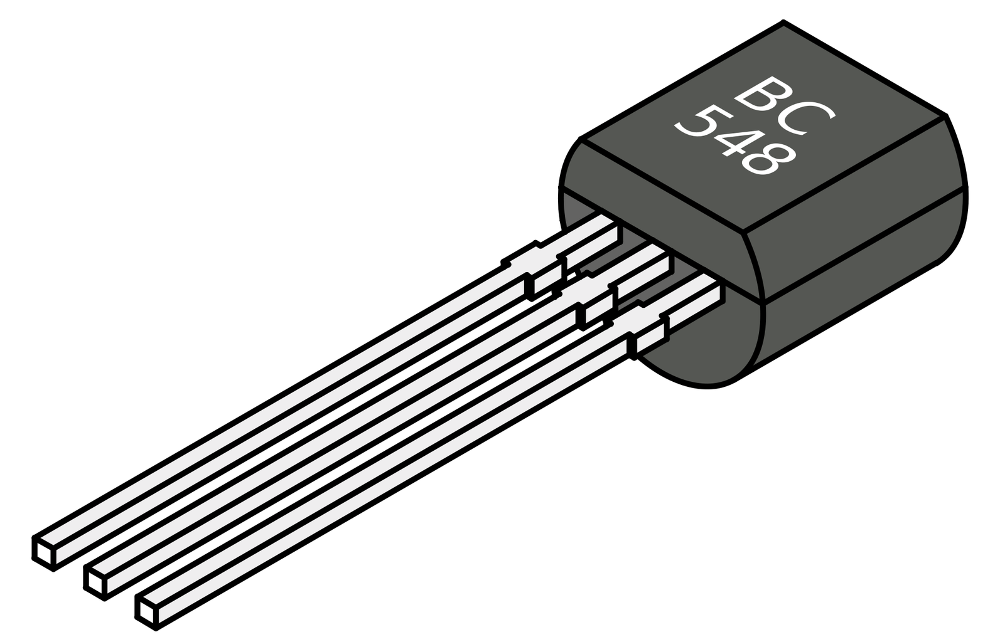
Mini Module 8: logic circuits
A transistor is like a tiny switch that can turn things on and off in an electronic device.
Imagine a light switch on the wall that you use to turn your lights on and off.
A transistor does something similar but inside things like computers, phones, and TVs. It can let electricity flow through or stop it, depending on what it needs to do.
Up = ON
Down = OFF
1 = ON
0 = OFF

Slide 3
Mini Module 8: logic circuits
AND
Transistor logic is the way that transistors are used to make decisions and perform calculations in electronic devices.
By combining transistors in different ways, we can create something called logic gates. These gates follow simple rules that can be followed to predict their output.
A
B
A and B
OR
A
A or B
B
NOT
A
A
Notes:
AND Gate: Both inputs need to be "on" for the output to be "on". If either one is "off", the output is "off".
OR Gate: If at least one input is "on", the output is "on". Both need to be "off" for the output to be "off".
NOT Gate: This one is a bit different. It only has one input and it flips it. If the input is "on", the output is "off", and vice versa.

Slide 4
Let's Learn About Transistor Logic Circuits
Will a device be on or off if inputs of 1 and 0 are put into an OR gate?
Explain how an AND gate works using a Venn diagram.
What does a NOT gate do to the input signal?
Transistor Logic Circuits Notebook:
https://github.com/megan-r-brown/Exploring-the-role-of-Materials-Chemistry-Biology-and-Electronics-in-Smartphones

